Slide 1





LET'S EXPLORE THE WORLD!
Presented by: SKYNAV

Slide 2



TOPIC OUTLINE
SEARCH FLIGHTS
Book a Flight
View Hotel INFO
Find Cheapest Route
Currency Converter
View Available Cities

Slide 3




INTRODUCTION

Slide 4

INTRODUCTION
We are committed to providing high-quality travel services around the world.
Allows users to search, view, and book flights
Uses intelligent algorithms to suggest the most efficient travel options
Developed as a Data Structures and Algorithms (DSA) project
Implements object-oriented programming (OOP) principles
Utilizes graphs for route and flight connectivity
Applies graph traversal algorithms for finding routes
Uses priority queues to calculate the cheapest travel paths
Employs linked lists for managing flight or booking data
Supports both direct and connecting flights
.

Slide 5


✈️ KEY DATA STRUCTURES USED
Graph (Adjacency List-based):
To represent the flight network between cities.
Queue (Linked List Implementation):
To manage a dynamic list of all flights available, and to handle bookings and flight data loading efficiently.
Priority Queue (Min-Heap):
Applied in Dijkstra’s Algorithm for finding the cheapest route between cities based on ticket prices.
Custom Node and Linked List:
Used in creating the adjacency list and flight queue structure for flexible memory handling.

Slide 6

FLIGHT & HOTEL

Slide 7




FLIGHT
Direct Flight: Lahore → Karachi | PIA | PKR 22,000
Cheapest Connecting Route: Islamabad → Dubai (via Karachi) | Dijkstra’s Algorithm
International Flight: Karachi → Istanbul | Hotel Available | USD 420

Slide 8





HOTEL
City Center Inn – Lahore
Skyline Luxury Hotel – Dubai
Palm View Resort – Istanbul
Grand Comfort Hotel – Karachi

Slide 9

THE ITINERARY & TRIP ESSENTIALS

Slide 10




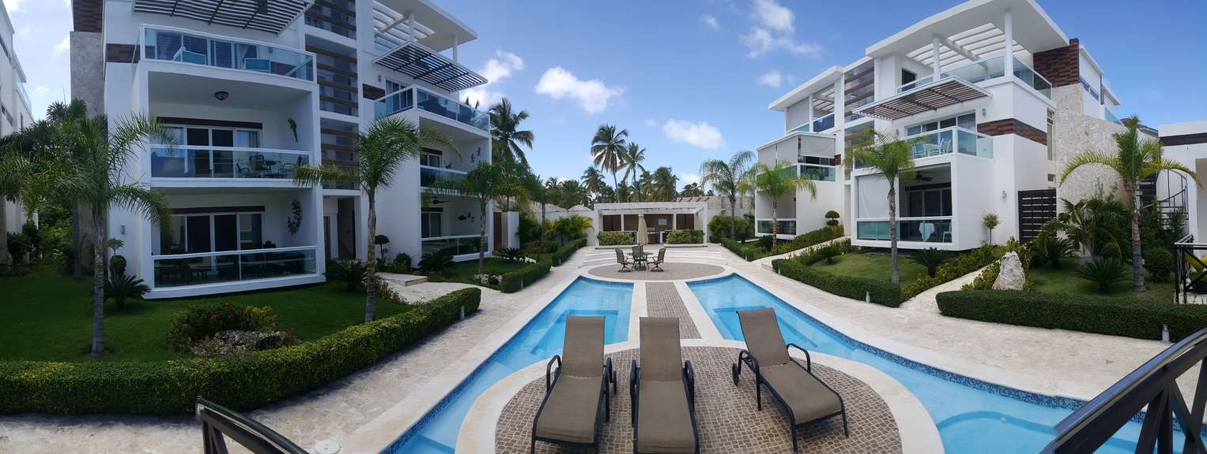
THE ITINERARY
Lahore (Departure City)
Istanbul (Final Destination)
Karachi (Connecting Flight)
Dubai (Layover City)

Slide 11









TRIP ESSENTIALS
Passport
Camera
Headphones
Tickets
Luggage
Clothes
Phone

Slide 12







BOOK YOUR NEXT VACATION WITH US!
123-456-7890
CONTACT US
HELLO@SKYNAV FLIGHT.COM
@SKYNAV FLIGHT
WWW.SKYNAV FLIGHT.COM
123-LDA, LHR CITY

Slide 13









FREE RESOURCE PAGE

Slide 14
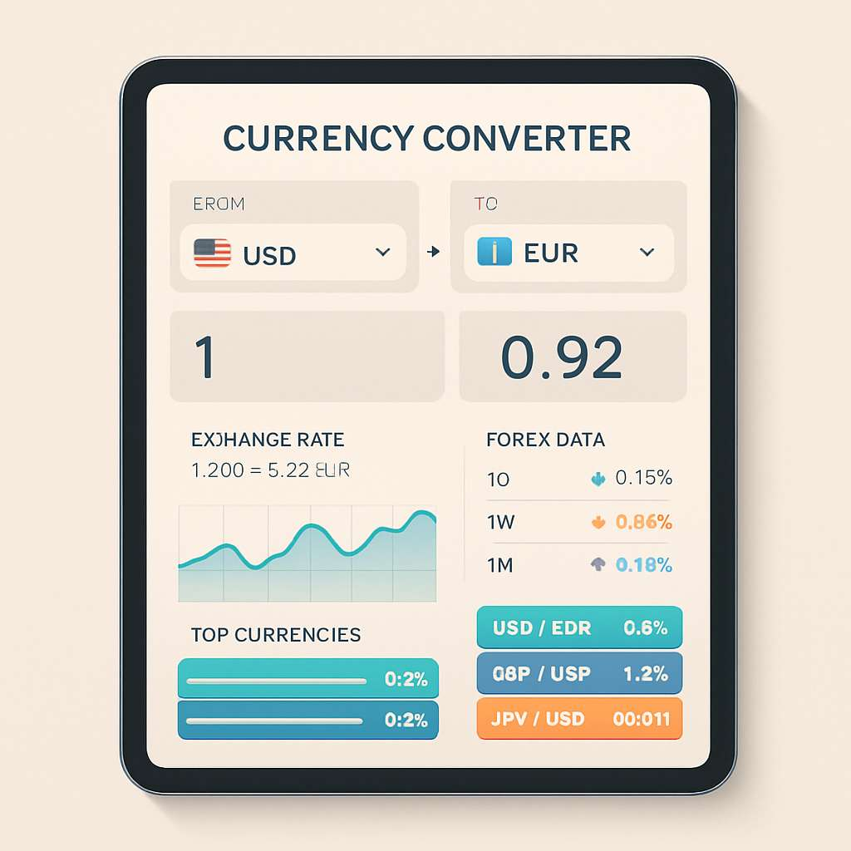

Slide 15


